Slide 1
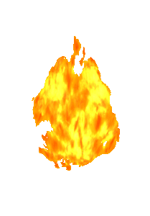
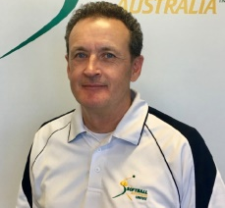
Hot Topic
Scoring and Rules of Softball Umpiring and Scoring Perspectives
Hosts:
Rowena Whittle
(National Scoring Committee-staff)
Leigh Evans
(National Umpiring Committee)

Slide 2
AGENDA
Welcome and Acknowledgements
Your Hosts and Support Staff
Online Protocols during sessions
responding- Chat
Questions topics
previously collated from an online form

Slide 3
AGENDA
Questions Topics
liaising with umpires and coaches
team scorer, or Official Scorer
changes to the starting lineup
3rd-out, run scores or not
blood-bin rules
appealing – getting the timing correct;
runner missed base on HR
intentional dead ball
interference, obstruction
OPR- references to Official Playing Rules

Slide 4
Liaising with others
Team Scorer - coach and team
- umpire
State Championships - team coach
- umpire
State Scorer at Nationals - changes from official scorer
Official at Nationals - plate umpire
OPR 3.7.1d The official scorer will not make a scoring decision that is inconsistent or in conflict with the OPR or an Umpire’s decision.

Slide 5
Official Scoring
State championships
usually selected by the State Director of Scoring or the State Tournament Chief Statistician (TCS)
usually familiar with some other members of the scoring team
liaise changes and substitutions with the umpire
manage communication of changes and substitutions to team scorers
National Championships
usually selected by Softball Australia
liaise with the TCS and may be familiar with others on the scoring team
liaise changes and substitutions with the umpire
manage communication of changes and substitutions to team scorers

Slide 6
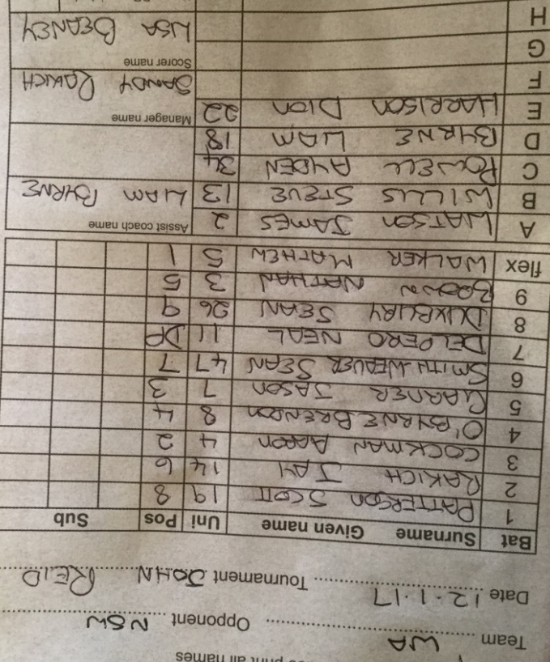
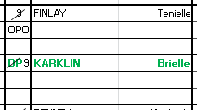
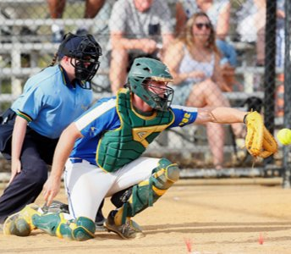
Changes to the starting line-up
OPR:3.2.3
3.2.5
Umpire will relay changes from team to the scorer
Umpire -when permitted?
-what is permitted?
Scorer
Announcing changes for Coaches, Umpires and Scorers
https://cdn.revolutionise.com.au/cups/softballaust/files/jzw6p3dwklbygufp.pdf

Slide 7
3rd-out, run scores or not
OPR:5.9
5.10.1
Umpire
Scorer:
Scoring Level 2: 6.2
A run is not scored if the third out of an innings is-
The batter-runner being put out before legally touching first base
A runner being forced out (including an appeal play)
A runner leaving a base before a pitch is released
A preceding runner being declared out

Slide 8
3rd-out, run scores or not
Example:
When could this run score?
Third out
Scoring Level 2: 6.2
Scoring Level 3: 3.1
A run can score if the third out of an innings is not a force out, and the run scores before the unforced third out occurs.

Slide 9
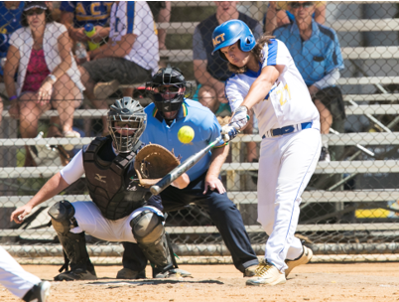
Blood-Bin rules
OPR 3.2.6
Umpire
Scorer:
Enter the name of the replacement player in red. Show where they enter the game and where the withdrawn player must return. This is indicated by placing a red * above the inning.
Scoring Level 2 12.6

Slide 10
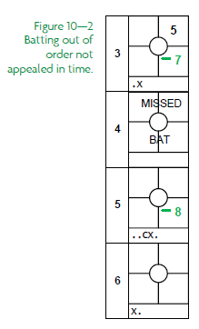
Appeals – getting the timing correct
OPR:5.4.1
Example: Batting Out of Order
1. If the appeal is made when the incorrect batter is at bat
2. If the appeal is made after the incorrect batter completes their turn at bat and before a pitch (legal or illegal) is thrown to the next batter.
3. If the appeal is made after the first pitch (legal or illegal) to the next batter.
Scoring Level 2 10.1

Slide 11
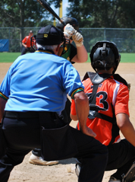
Appeals –illegal substitute: when to appeal
OPR:3.1.10
Batting (other than Batting Out of Order) – the illegal substitute is batting
Base Running- the illegal substitute is on base
Fielding- the illegal substitute is fielding
Scoring Level 3- 5.1

Slide 12
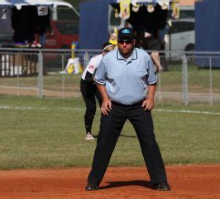
Appeals – illegal re-entry
OPR:3.1.9
Watch out for illegal re-entry relating to DP or FLEX players.
Batting
AND …..
Returns to the game

Slide 13
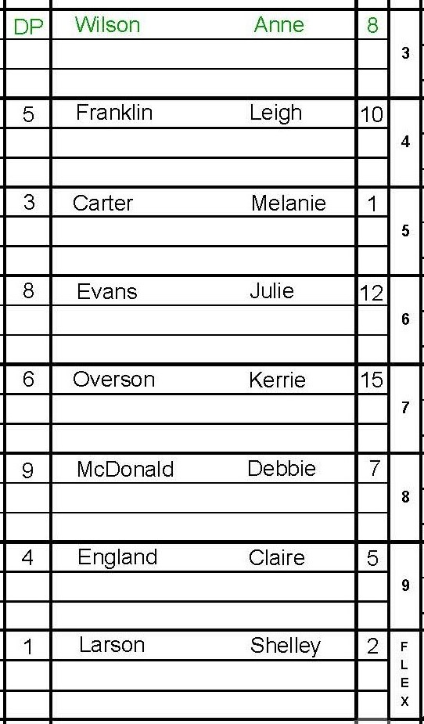
Batting change: Flex batting #8 is off
1
Larson Shelley
2
FLEX replaces DP on offence
(LARSON bats for WILSON)
The FLEX (or their substitute) can ONLY bat in this position
NOTE: Any Batting Extensions for LARSON will now appear on the line below WILSON in the scorebook. Fielding data (PO, A, E) will now appear adjacent to Larson in the 3rd Batters position
The number of players has reduced from 10 to 9.

Slide 14
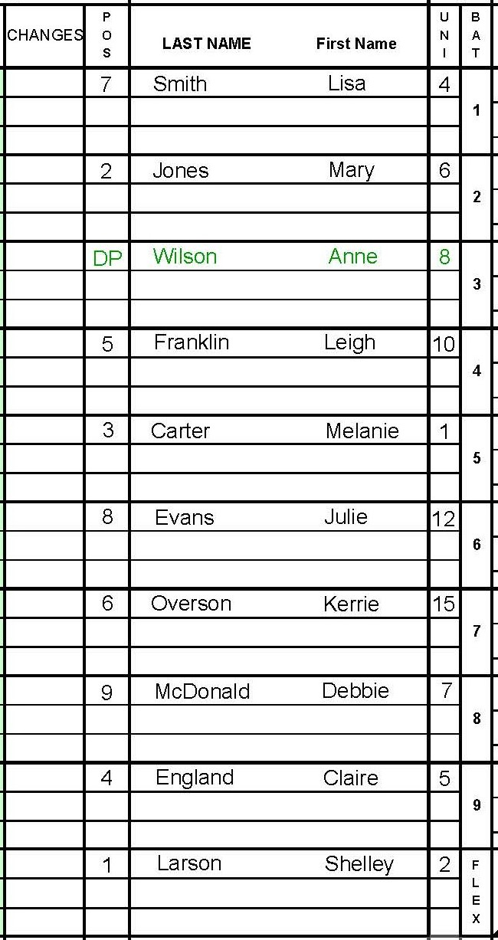
Batting change: #8 off
Fielding change: #2 is off
Larson Shelley
DP replaces FLEX on defence
1
2
FLEX replaces DP on offence
T1/1
1
WILSON fields - as new Pitcher
Players reduced from 10 to 9
Players reduced from 10 to 9
T1/1
Player can re-enter in both scenarios

Slide 15
DP and FLEX Golden Rules
If a DP is going to be used, they must be listed on the line-up from the start of the game = 10 Players
As the DP and Flex are starting players, they are eligible for re-entry
Only nine (9) players may bat
The DP can field for any of the 8 players or for the Flex but can NEVER field only.
The player for whom the DP is fielding becomes the Offensive player only. OPO.
The Flex can only bat in the DP’s batting position but can NEVER bat only
The DP and Flex can NEVER bat at the same time but can field at the same time.
If the FLEX in not playing DEFENCE, they are considered to have left the game = 9 players.
If the DP is not playing OFFENCE, they are considered to have left the game = 9 players.
If the DP or FLEX re-enters into a place other than the DP position the coach & the player are ejected (illegal re-entry).

Slide 16
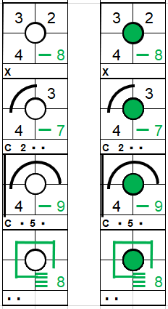
Two-out, loaded bases …….
OPR 5.9g
5.10.5d
With two-out, loaded bases, Batter B4 hits a Home run, over the fence.
Runner passing a runner Technical Bulletin https://www.softball.org.au/technical-bulletins-/

Slide 17
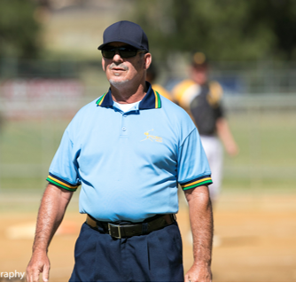
Two-out, loaded bases …….
OPR 5.9g
5.10.5d
With two-out, loaded bases, Batter B4 hits a Home run, over the fence.
B2 has missed 3rd base when running home.
The defensive team throw the ball to 3rd base and Appeal, and the Out is awarded.
What runs score?
Next

Slide 18
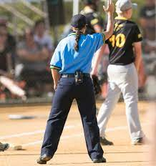
Intentional dead ball - IDB
If, in the opinion of the umpire, the fielder intentionally carries the ball across the dead ball line following a catch, any base runners will be awarded two bases.
Show this advance as IDB with an arc drawn in red.
Scoring Level 3 2.6

Slide 19
Interference - INT*
OPR 5.1.30
5.5.1d, 5.10.3
Getting out;
An offensive player who impedes, hinders or confuses a defensive player attempting to execute a play
A batter-runner who steps back towards home plate to avoid
a tag (eg by first base, INT3 )
A runner is out when they are struck with an untouched, fair-batted ball in fair territory while off-base and a fielder had an opportunity to make an out
Scoring Level 2 – 4.6

Slide 20
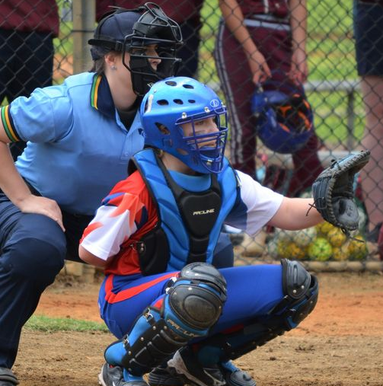
Obstruction - OBS*
OPR 5.1.32
5.5.1d, 5.10.2
Getting on base;
When the catcher or defensive player prevents the batter from striking at or hitting a pitched ball; a) they are awarded first base. Eg Use symbol OBS2 (if Catcher)
OR b) they hit safely and no runners put out, then safe hit is recorded and Obstruction is cancelled
OR
c) eg OBS6 (if short-stop has affected the advance to 3rd)
In short: BIFO- Batters interfere, fielders obstruct
Scoring Level 3 3.6

Slide 21
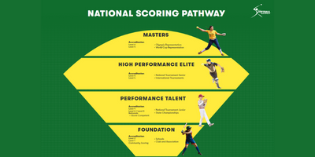
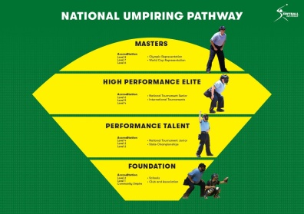
Q&A
Final Questions
Thank you to all participants

Slide 22
Thank you to Leigh Evans and the support staff
Watch out for notification of our next online Hot Topic

